Slide 1

Introduction to Computer Vision
By Anshika Malsaria
Assistant Professor
CCE
Notes:
1

Slide 2
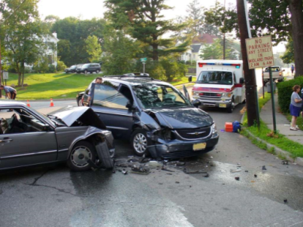
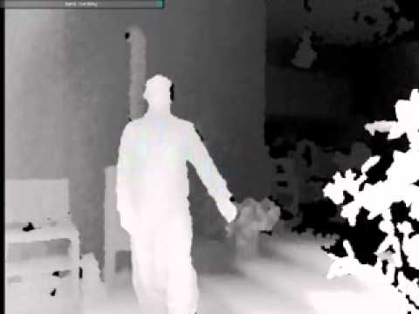
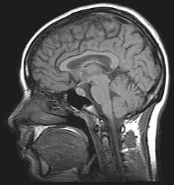
What is Computer Vision?
Computer vision is the science and technology of machines that see.
Concerned with the theory for building artificial systems that obtain information from images.
The image data can take many forms, such as a video sequence, depth images, views from multiple cameras, or multi-dimensional data from a medical scanner
Notes:
2

Slide 3
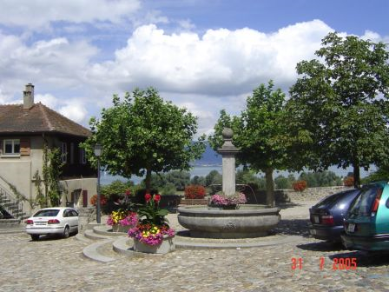
Computer Vision
Make computers understand images and videos.
What kind of scene?
Where are the cars?
How far is the building?
…

Slide 4

Components of a computer vision system
Camera
Lighting
Computer
Scene
Scene Interpretation
Srinivasa Narasimhan’s slide

Slide 5

Computer Graphics - Synthesis
Projection, shading, lighting models
Output:
Image
Model
Synthetic Camera

Slide 6


Computer Vision -Analysis
Output:
Model
Real Scene
Cameras
Images

Slide 7
Computer Vision
Imaging process:
image = f (world)
including lighting, camera location and parameters, ...
Computer vision
world = f ⁻¹ (image)
So a goal of computer vision is to recover the inverse
function that creates images from the world
Is this possible? Why or why not?

Slide 8
Relation to other fields
AI
Statistics
Image processing
Robotics
Computer vision
Human vision
-Visual physiology
- Psychophysics
Optics
Computer graphics
Pattern recognition
Machine learning

Slide 9

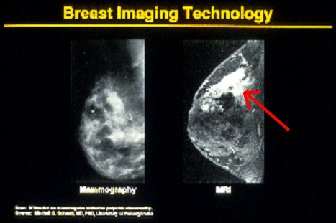

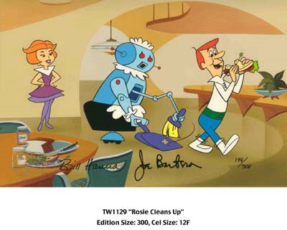
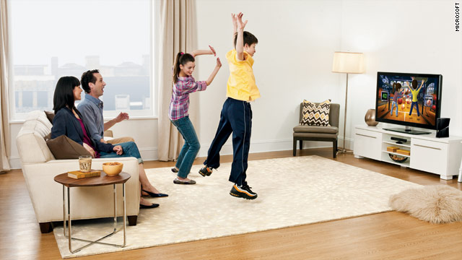
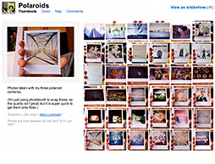
Why computer vision matters
Safety
Health
Security
Comfort
Fun
Access

Slide 10
Some applications of computer vision
Photogrammetry, GIS
Commercial, military, government
Robotics
Industrial, military, medical, space, entertainment
Inspection, measurement
Medical imaging
Automatic detection, outlining, measurement
Graphics and animation, special effects
Surveillance and security
Multimedia database indexing and retrieval, compression
Human-computer interaction (HCI)

Slide 11
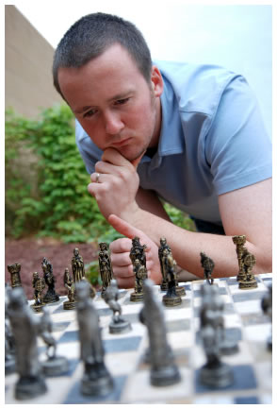
Vision is really hard
Vision is an amazing feat of natural intelligence
Visual cortex occupies about 50% of Macaque brain
More human brain devoted to vision than anything else
Is that a queen or a bishop?

Slide 12
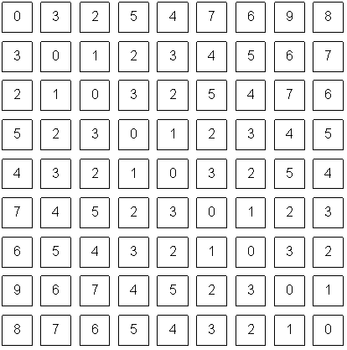
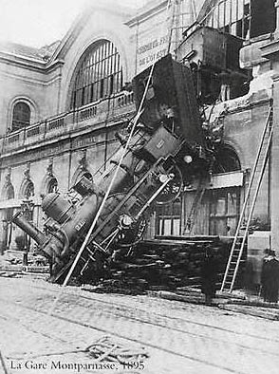
Computer vision vs human vision
What we see
What a computer sees

Slide 13


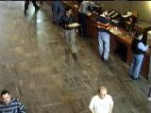
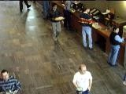
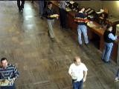

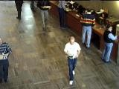

What Does Computer Vision Do?
3D models of objects Object recognition Navigation
Event/action recognition
…

Slide 14
Vision Transforms From This…
01 00 05 00 03 00 02 00 00 03 01 01 01 01 00 00 00 00 00 00 00 00 00 00 00 00 00 00 00 00 00 00 00 00 00 00 00 02 00 01
03 30 3A 38 39 2D 1D 15 10 0E 0C 0A 0A 0A 09 06 08 07 06 06 05 05 07 07 04 05 04 04 06 02 01 02 02 02 02 07 01 02 02 03
03 22 1B 16 14 0A 08 0B 0A 0D 0B 0B 0C 06 07 05 05 06 06 06 03 07 04 06 05 09 05 04 05 01 04 04 02 03 03 04 02 04 03 02
00 0F 0B 04 10 07 09 07 08 09 09 08 05 08 08 05 09 03 08 05 02 08 08 06 06 04 02 05 03 02 05 05 00 02 02 04 04 00 00 03
00 07 09 0E 0C 07 08 0A 0A 0B 0F 0A 0C 07 06 0B 07 0B 05 0B 08 09 07 03 08 04 04 02 00 04 02 04 00 04 03 08 00 06 09 04
00 0E 0C 09 09 08 08 07 08 09 09 0A 05 08 07 07 07 09 08 0A 08 09 06 0A 03 09 07 06 06 03 05 03 01 06 02 03 07 01 04 04
02 0C 0B 0A 05 08 09 0A 0C 0A 0A 08 0A 0A 06 08 06 06 04 06 02 06 07 04 04 04 06 09 05 05 08 06 04 05 04 06 01 0A 03 02
02 0B 14 0F 0F 0D 0A 0E 0A 0C 0C 0E 0A 0C 0B 09 0A 09 0A 0A 09 0B 0B 05 0C 0C 0A 04 07 06 03 05 07 04 05 03 02 01 06 03
02 10 12 0B 10 0A 0D 0D 0B 0D 0C 0B 0B 0C 0D 0B 0B 0A 0A 0A 0B 0C 17 15 1C 15 0D 08 09 08 05 05 05 04 02 05 04 04 00 04
01 15 0E 10 12 0C 0D 0C 0C 0A 0B 0B 09 0C 0F 09 09 0D 07 0B 08 15 60 5D 61 59 33 0D 0A 07 08 08 05 03 06 07 01 03 05 02
02 12 10 0F 0E 10 10 0B 0C 0F 0F 0E 0C 10 0D 15 10 09 12 11 12 50 68 66 89 71 5E 3F 08 09 0A 09 0A 03 03 02 05 05 04 02
01 11 12 0C 11 13 10 10 0B 10 0F 0C 11 11 13 0D 0F 0D 0D 0B 25 7A 7F 79 6D 80 6E 54 0C 0D 09 0A 06 04 02 05 00 05 04 03
01 10 0F 0D 12 0E 10 0E 0F 13 13 11 13 17 11 0F 14 11 11 14 39 84 88 7E 8C 73 7A 5C 1E 05 0A 0F 0E 0C 05 02 04 03 06 05
02 0F 15 0D 18 11 0D 11 14 10 12 12 14 19 13 17 13 16 16 20 73 68 87 89 93 8B 83 69 43 07 0A 12 0A 0B 06 06 03 04 05 03
02 13 14 14 16 11 13 13 17 12 17 17 28 1E 1A 17 19 14 12 4F 7D 74 85 91 93 8C 7F 6F 5F 0B 09 12 0D 0C 02 04 07 04 05 04
00 0F 16 0F 13 12 10 1D 12 21 15 1E 21 1F 1C 1D 2D 1A 2D 7C 7A 95 6B 30 48 62 87 71 5C 0A 08 11 0C 09 04 04 02 06 04 03
00 10 1C 10 11 1A 0D 1A 1A 25 28 33 30 26 2B 3E 29 35 6C 83 5E 7B 94 8A 5A 3D 42 76 5C 13 08 13 0F 0C 04 04 01 05 05 03
01 12 17 1A 19 18 15 20 29 20 3F 1F 37 29 39 49 24 33 8F 93 B4 AE 79 42 39 73 7D 89 46 12 06 12 12 0F 08 03 03 03 04 03
01 13 20 0F 14 26 1B 18 20 2F 3D 3E 42 3B 45 2E 48 70 96 9F 96 6B 24 0F 22 4B C3 A4 3F 4F 0C 18 16 0F 05 05 08 05 05 04
00 19 1C 13 13 21 1D 12 18 47 3D 47 45 3A 27 3B 33 A8 A6 91 81 4B A1 75 4B AC A1 B5 79 0C 0B 13 0F 0B 02 03 06 07 07 04
00 1B 1D 1C 1C 1C 1B 1B 1E 55 49 49 36 28 2A 24 9F AD AC AA B1 9C 8D 5F 3E 98 B7 B7 A3 31 11 14 0A 0D 04 08 07 07 07 06
02 21 18 15 16 1D 15 18 1E 36 5B 29 2C 19 29 4F AF BC AF AB 9E A1 97 82 70 9F AE AD A5 92 16 10 07 0E 0A 0C 08 05 0B 05
01 17 1B 1A 1A 2B 1B 2A 32 34 46 2C 1B 26 4C 40 BA BB B5 AE 95 94 84 7A 8A 9A B9 BB AD 9C 8A 15 09 09 05 0B 0D 0F 0B 07
00 1A 18 1C 1E 27 21 1D 3F 4E 32 25 1B 1B 93 46 AF AB B1 AC A4 93 89 91 86 90 AA 9F 91 97 AD 7F 0C 0B 0E 0B 0C 0C 09 05
00 15 1A 21 1E 2E 1B 23 47 4E 23 21 19 49 99 5B AA AC B7 AF A6 9A 93 8F 85 7F A0 A4 C2 9F 99 4E 09 08 0A 0D 0C 0A 0C 07
00 13 18 21 26 31 28 25 34 4C 1F 2B 1C 8B 9B 42 9B A7 A1 B4 B0 AA A0 9D 92 72 8E 97 71 A7 32 04 0A 0A 0D 0D 09 0D 0C 07
00 1A 1C 21 28 3A 30 26 40 4C 26 18 2C 90 A1 39 A0 97 B8 AA B2 A5 A6 A3 98 76 92 96 98 6D 08 0D 07 08 0C 0B 0E 0D 0D 0A
04 1E 29 1F 27 32 26 2E 41 4A 2C 34 46 8A A5 89 9E A3 B0 B7 AF AB AB 99 97 90 A4 94 85 7C 08 07 07 08 09 09 08 0C 0D 0B
01 1F 29 27 27 2A 2C 36 4D 50 34 42 45 95 9B AA 7E AD B3 AA B2 A8 B2 92 98 8E 9E 8E 44 34 18 05 06 0A 0D 0D 0D 0F 0C 08
00 21 2E 23 29 2C 2A 34 44 5A 39 4F 29 90 9B A5 86 AA B2 B3 AE A0 A3 9C 94 79 43 2B 25 2D 07 0E 05 06 0C 0A 0F 0D 09 0C
00 21 27 20 28 29 2F 2A 44 57 42 31 28 8C 93 A3 AC 60 BA BD B4 AE A8 A2 62 91 5F 52 4F 3F 09 0D 0D 09 0E 0E 0B 12 0B 0B
03 30 2E 2C 29 2A 3B 30 4E 3C 40 40 49 5E AE 9F A4 B1 4E AA AA A0 A4 9C 94 A2 AB A8 93 52 0E 0E 09 0B 0D 10 0C 0C 10 09
00 30 32 2E 36 39 36 24 2D 5A 46 46 68 30 8B 8C A3 AC A5 3E A1 AF A8 82 A4 AC A2 96 71 73 08 10 0B 0B 0B 0E 0F 10 11 0A
00 54 34 1E 3C 3F 3E 29 27 56 38 4C 5C 44 26 94 9A A2 A2 A6 8E 4E 70 99 AC A6 A2 89 7E 5B 11 0E 10 10 17 12 0D 0C 0D 0C
00 4B 30 23 36 44 48 3C 2E 2D 34 35 29 58 5B 0D 36 50 34 52 9C A8 B5 AA B3 AE A0 9C 8C 62 0A 12 14 0D 16 14 11 10 0E 0D
01 38 2C 24 2E 51 59 4B 30 27 39 2B 2B 24 29 69 37 25 29 82 97 A1 AB AC B2 A6 A6 A0 89 69 0F 10 1C 18 14 10 10 0F 0C 0F
03 21 2A 27 22 5C 44 31 3F 33 1F 37 24 23 36 27 24 2B 4D 50 85 90 96 86 A3 A5 99 8D 7A 4E 0E 1B 15 20 0F 0F 16 12 13 0B
01 1D 1F 2B 20 21 48 2F 40 2F 2D 2A 25 2B 2C 20 25 25 26 3E 55 5E 62 6D 6D 6E 68 5E 43 0D 10 21 18 32 1A 13 10 13 15 10
04 27 2F 2A 28 21 3B 45 2E 3A 40 33 2D 2F 1F 1E 1B 20 37 3C 3F 3C 34 30 24 17 0D 0B 0E 11 1E 23 1B 25 14 0D 10 0F 12 0F
04 22 27 37 33 1A 1B 35 4A 1D 20 2C 2F 1F 1F 3B 34 1A 2A 38 44 1E 0C 0C 06 0C 10 12 1B 21 21 34 32 20 0B 0E 10 0D 0D 0F
02 32 22 33 29 20 22 19 30 35 1D 1E 16 19 18 1C 16 18 23 39 10 13 0E 0E 1A 15 15 13 1A 18 2C 2E 19 0F 0D 10 0E 0E 14 0D
01 33 36 23 31 29 20 19 1B 1E 17 1C 1F 1F 1F 1C 31 23 1C 2F 13 11 16 10 12 16 13 19 1B 17 19 1D 13 14 10 10 12 11 12 0D
01 28 31 34 24 30 23 19 18 28 2A 1D 1F 1D 1B 1E 1B 26 31 39 16 14 13 14 13 15 1B 22 1A 1E 1B 15 13 16 0C 0D 11 0E 12 0D
00 29 20 1C 2E 25 28 28 22 1E 20 1F 1F 1D 1B 1C 29 22 43 37 17 10 15 15 12 10 14 15 1B 1E 15 1A 11 10 14 13 14 17 12 11
01 25 28 2A 23 23 29 26 1E 1D 34 38 1B 1B 22 26 18 1A 4C 33 1C 11 14 14 14 10 10 18 17 1E 29 20 1A 15 12 17 0E 14 12 12

Slide 15
To this…
Objects
Cat, chair, window, star, bush, water, a shoe, my mother…
Properties
Big, bright, yellow, fast, graspable, moving…
Relations
In front, behind, on top, next to, larger, closer, identical…
Shapes
Round, rectangular, star-shaped, symmetric…
Textures
Rough, smooth, irregular…
Movement
Turning, looming, rolling…

Slide 16
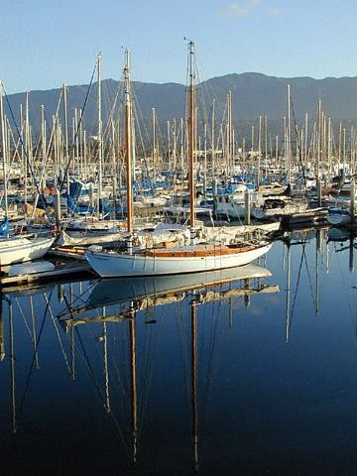
“A harbor with many dozens of boats; water is calm and glassy; masts are all vertical; mountains in background, blue sky with a touch of clouds…”

Slide 17
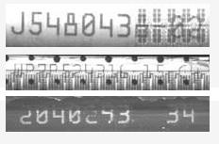
“J548043”

Slide 18
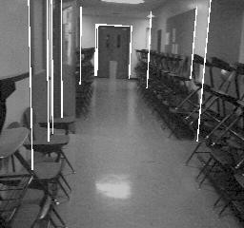
“Hallway straight ahead”

Slide 19
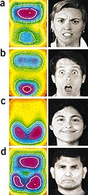
“Angry
Surprised Happy Disgusted”

Slide 20
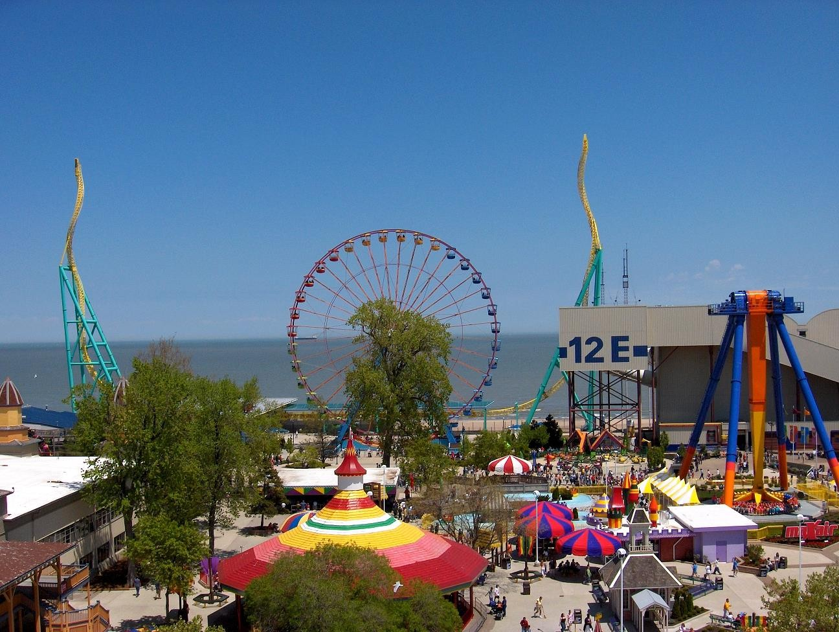
Objects Activities Scenes Locations Text / writing Faces Gestures
amusement park
sky
The Wicked Twister
Cedar Point
ride
Ferris
wheel
ride
12 E
Lake Erie
water
Motions
ride
tree
Emotions…
tree
people waiting in line
people sitting on ride
umbrellas
tree
maxair
carousel
deck
bench
tree
pedestrians

Slide 21

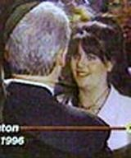

Why is Vision Difficult?
Consider the input...
Not this

Slide 22
But this…
01 00 05 00 03 00 02 00 00 03 01 01 01 01 00 00 00 00 00 00 00 00 00 00 00 00 00 00 00 00 00 00 00 00 00 00 00 02 00 01
03 30 3A 38 39 2D 1D 15 10 0E 0C 0A 0A 0A 09 06 08 07 06 06 05 05 07 07 04 05 04 04 06 02 01 02 02 02 02 07 01 02 02 03
03 22 1B 16 14 0A 08 0B 0A 0D 0B 0B 0C 06 07 05 05 06 06 06 03 07 04 06 05 09 05 04 05 01 04 04 02 03 03 04 02 04 03 02
00 0F 0B 04 10 07 09 07 08 09 09 08 05 08 08 05 09 03 08 05 02 08 08 06 06 04 02 05 03 02 05 05 00 02 02 04 04 00 00 03
00 07 09 0E 0C 07 08 0A 0A 0B 0F 0A 0C 07 06 0B 07 0B 05 0B 08 09 07 03 08 04 04 02 00 04 02 04 00 04 03 08 00 06 09 04
00 0E 0C 09 09 08 08 07 08 09 09 0A 05 08 07 07 07 09 08 0A 08 09 06 0A 03 09 07 06 06 03 05 03 01 06 02 03 07 01 04 04
02 0C 0B 0A 05 08 09 0A 0C 0A 0A 08 0A 0A 06 08 06 06 04 06 02 06 07 04 04 04 06 09 05 05 08 06 04 05 04 06 01 0A 03 02
02 0B 14 0F 0F 0D 0A 0E 0A 0C 0C 0E 0A 0C 0B 09 0A 09 0A 0A 09 0B 0B 05 0C 0C 0A 04 07 06 03 05 07 04 05 03 02 01 06 03
02 10 12 0B 10 0A 0D 0D 0B 0D 0C 0B 0B 0C 0D 0B 0B 0A 0A 0A 0B 0C 17 15 1C 15 0D 08 09 08 05 05 05 04 02 05 04 04 00 04
01 15 0E 10 12 0C 0D 0C 0C 0A 0B 0B 09 0C 0F 09 09 0D 07 0B 08 15 60 5D 61 59 33 0D 0A 07 08 08 05 03 06 07 01 03 05 02
02 12 10 0F 0E 10 10 0B 0C 0F 0F 0E 0C 10 0D 15 10 09 12 11 12 50 68 66 89 71 5E 3F 08 09 0A 09 0A 03 03 02 05 05 04 02
01 11 12 0C 11 13 10 10 0B 10 0F 0C 11 11 13 0D 0F 0D 0D 0B 25 7A 7F 79 6D 80 6E 54 0C 0D 09 0A 06 04 02 05 00 05 04 03
01 10 0F 0D 12 0E 10 0E 0F 13 13 11 13 17 11 0F 14 11 11 14 39 84 88 7E 8C 73 7A 5C 1E 05 0A 0F 0E 0C 05 02 04 03 06 05
02 0F 15 0D 18 11 0D 11 14 10 12 12 14 19 13 17 13 16 16 20 73 68 87 89 93 8B 83 69 43 07 0A 12 0A 0B 06 06 03 04 05 03
02 13 14 14 16 11 13 13 17 12 17 17 28 1E 1A 17 19 14 12 4F 7D 74 85 91 93 8C 7F 6F 5F 0B 09 12 0D 0C 02 04 07 04 05 04
00 0F 16 0F 13 12 10 1D 12 21 15 1E 21 1F 1C 1D 2D 1A 2D 7C 7A 95 6B 30 48 62 87 71 5C 0A 08 11 0C 09 04 04 02 06 04 03
00 10 1C 10 11 1A 0D 1A 1A 25 28 33 30 26 2B 3E 29 35 6C 83 5E 7B 94 8A 5A 3D 42 76 5C 13 08 13 0F 0C 04 04 01 05 05 03
01 12 17 1A 19 18 15 20 29 20 3F 1F 37 29 39 49 24 33 8F 93 B4 AE 79 42 39 73 7D 89 46 12 06 12 12 0F 08 03 03 03 04 03
01 13 20 0F 14 26 1B 18 20 2F 3D 3E 42 3B 45 2E 48 70 96 9F 96 6B 24 0F 22 4B C3 A4 3F 4F 0C 18 16 0F 05 05 08 05 05 04
00 19 1C 13 13 21 1D 12 18 47 3D 47 45 3A 27 3B 33 A8 A6 91 81 4B A1 75 4B AC A1 B5 79 0C 0B 13 0F 0B 02 03 06 07 07 04
00 1B 1D 1C 1C 1C 1B 1B 1E 55 49 49 36 28 2A 24 9F AD AC AA B1 9C 8D 5F 3E 98 B7 B7 A3 31 11 14 0A 0D 04 08 07 07 07 06
02 21 18 15 16 1D 15 18 1E 36 5B 29 2C 19 29 4F AF BC AF AB 9E A1 97 82 70 9F AE AD A5 92 16 10 07 0E 0A 0C 08 05 0B 05
01 17 1B 1A 1A 2B 1B 2A 32 34 46 2C 1B 26 4C 40 BA BB B5 AE 95 94 84 7A 8A 9A B9 BB AD 9C 8A 15 09 09 05 0B 0D 0F 0B 07
00 1A 18 1C 1E 27 21 1D 3F 4E 32 25 1B 1B 93 46 AF AB B1 AC A4 93 89 91 86 90 AA 9F 91 97 AD 7F 0C 0B 0E 0B 0C 0C 09 05
00 15 1A 21 1E 2E 1B 23 47 4E 23 21 19 49 99 5B AA AC B7 AF A6 9A 93 8F 85 7F A0 A4 C2 9F 99 4E 09 08 0A 0D 0C 0A 0C 07
00 13 18 21 26 31 28 25 34 4C 1F 2B 1C 8B 9B 42 9B A7 A1 B4 B0 AA A0 9D 92 72 8E 97 71 A7 32 04 0A 0A 0D 0D 09 0D 0C 07
00 1A 1C 21 28 3A 30 26 40 4C 26 18 2C 90 A1 39 A0 97 B8 AA B2 A5 A6 A3 98 76 92 96 98 6D 08 0D 07 08 0C 0B 0E 0D 0D 0A
04 1E 29 1F 27 32 26 2E 41 4A 2C 34 46 8A A5 89 9E A3 B0 B7 AF AB AB 99 97 90 A4 94 85 7C 08 07 07 08 09 09 08 0C 0D 0B
01 1F 29 27 27 2A 2C 36 4D 50 34 42 45 95 9B AA 7E AD B3 AA B2 A8 B2 92 98 8E 9E 8E 44 34 18 05 06 0A 0D 0D 0D 0F 0C 08
00 21 2E 23 29 2C 2A 34 44 5A 39 4F 29 90 9B A5 86 AA B2 B3 AE A0 A3 9C 94 79 43 2B 25 2D 07 0E 05 06 0C 0A 0F 0D 09 0C
00 21 27 20 28 29 2F 2A 44 57 42 31 28 8C 93 A3 AC 60 BA BD B4 AE A8 A2 62 91 5F 52 4F 3F 09 0D 0D 09 0E 0E 0B 12 0B 0B
03 30 2E 2C 29 2A 3B 30 4E 3C 40 40 49 5E AE 9F A4 B1 4E AA AA A0 A4 9C 94 A2 AB A8 93 52 0E 0E 09 0B 0D 10 0C 0C 10 09
00 30 32 2E 36 39 36 24 2D 5A 46 46 68 30 8B 8C A3 AC A5 3E A1 AF A8 82 A4 AC A2 96 71 73 08 10 0B 0B 0B 0E 0F 10 11 0A
00 54 34 1E 3C 3F 3E 29 27 56 38 4C 5C 44 26 94 9A A2 A2 A6 8E 4E 70 99 AC A6 A2 89 7E 5B 11 0E 10 10 17 12 0D 0C 0D 0C
00 4B 30 23 36 44 48 3C 2E 2D 34 35 29 58 5B 0D 36 50 34 52 9C A8 B5 AA B3 AE A0 9C 8C 62 0A 12 14 0D 16 14 11 10 0E 0D
01 38 2C 24 2E 51 59 4B 30 27 39 2B 2B 24 29 69 37 25 29 82 97 A1 AB AC B2 A6 A6 A0 89 69 0F 10 1C 18 14 10 10 0F 0C 0F
03 21 2A 27 22 5C 44 31 3F 33 1F 37 24 23 36 27 24 2B 4D 50 85 90 96 86 A3 A5 99 8D 7A 4E 0E 1B 15 20 0F 0F 16 12 13 0B
01 1D 1F 2B 20 21 48 2F 40 2F 2D 2A 25 2B 2C 20 25 25 26 3E 55 5E 62 6D 6D 6E 68 5E 43 0D 10 21 18 32 1A 13 10 13 15 10
04 27 2F 2A 28 21 3B 45 2E 3A 40 33 2D 2F 1F 1E 1B 20 37 3C 3F 3C 34 30 24 17 0D 0B 0E 11 1E 23 1B 25 14 0D 10 0F 12 0F
04 22 27 37 33 1A 1B 35 4A 1D 20 2C 2F 1F 1F 3B 34 1A 2A 38 44 1E 0C 0C 06 0C 10 12 1B 21 21 34 32 20 0B 0E 10 0D 0D 0F
02 32 22 33 29 20 22 19 30 35 1D 1E 16 19 18 1C 16 18 23 39 10 13 0E 0E 1A 15 15 13 1A 18 2C 2E 19 0F 0D 10 0E 0E 14 0D
01 33 36 23 31 29 20 19 1B 1E 17 1C 1F 1F 1F 1C 31 23 1C 2F 13 11 16 10 12 16 13 19 1B 17 19 1D 13 14 10 10 12 11 12 0D
01 28 31 34 24 30 23 19 18 28 2A 1D 1F 1D 1B 1E 1B 26 31 39 16 14 13 14 13 15 1B 22 1A 1E 1B 15 13 16 0C 0D 11 0E 12 0D
00 29 20 1C 2E 25 28 28 22 1E 20 1F 1F 1D 1B 1C 29 22 43 37 17 10 15 15 12 10 14 15 1B 1E 15 1A 11 10 14 13 14 17 12 11
01 25 28 2A 23 23 29 26 1E 1D 34 38 1B 1B 22 26 18 1A 4C 33 1C 11 14 14 14 10 10 18 17 1E 29 20 1A 15 12 17 0E 14 12 12
02 25 23 21 21 24 27 28 22 1E 2D 2D 23 1D 25 28 27 2A 5F 24 22 15 14 13 19 15 16 15 17 1A 1B 34 29 1B 16 17 16 16 17 12
00 24 1F 20 28 22 1B 22 27 20 17 1E 1B 20 22 21 1C 5E 72 23 18 25 16 15 11 0F 17 15 14 14 18 1F 21 1B 16 18 10 13 16 10
02 24 23 25 21 24 21 22 24 28 2F 26 23 1A 1D 16 21 B0 2C 26 22 2C 22 1D 1A 10 1A 1D 1A 13 14 1C 21 1B 17 17 17 13 13 14

Slide 23

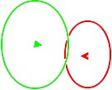
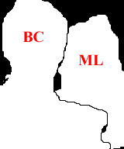














Some Possible Outputs
depth
or segmentation
object pose (facing away, facing forward)
object
recognition
action understanding

Slide 24






























What Your Brain Does
Clinton greeting Lewinsky
Person with glasses in crowd
Almost certain to be Bill Clinton
Gray hair
Pony tail
Dark brown hair Right eye (open)
Left eye (open)
Nose
Cheek
Monica’s mouth (smiling)
Dark circular overlay
Right ear
Neck
White shirt
Armani suit
Person
contour
CNN caption
Lapel
Illuminated
from above
(Washington 1995?)
Clinton occluding
Monica
Necklace
Monica Lewinsky
Woman’s dress suit

Slide 25
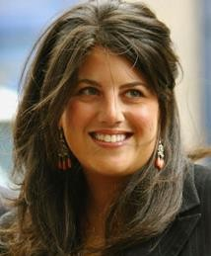
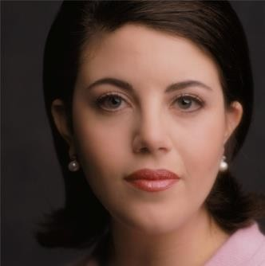
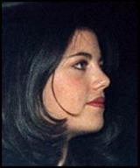
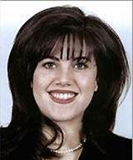
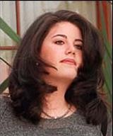
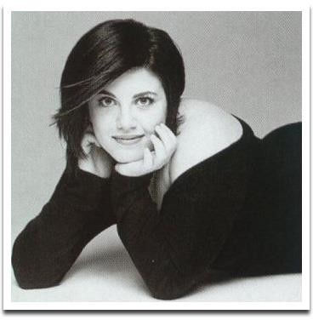
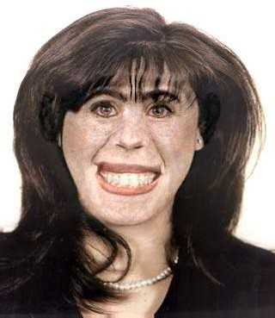
Variation in Appearance

Slide 26
What makes computer vision hard?
Underspecified, ill-posed problem!
3D world projected onto 2D sensor(s)
Environment
Lighting, background, movement, camera
Varying appearance of objects
Calibration, FOV, camera control, image quality
Computational complexity (speed of processing)
Etc., etc….
Robustness is the primary challenge to computer vision!

Slide 27
Progress in Computer Vision
First generation: Military/Early Research
Few systems, each custom-built, cost $Ms
“Users” have PhDs
1 hour per frame
Second generation: Industrial/Medical
Numerous systems, 1-1000 of each, cost $10Ks
Users have college degree
RT with special hardware
Third generation: Consumer
100000(00) systems, cost $100s
Users have little or no training
RT in software

Slide 28
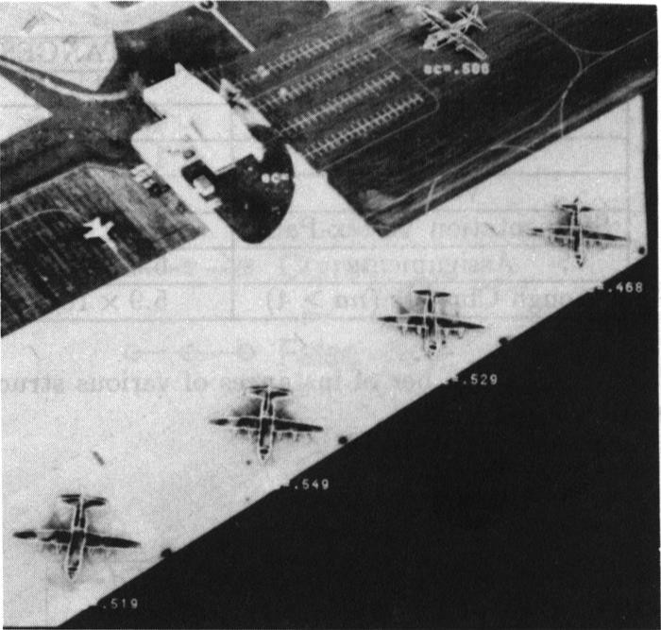
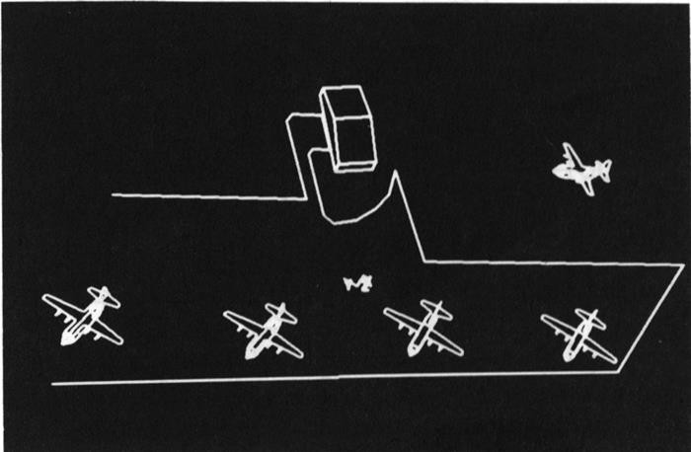
Early CV research

Slide 29
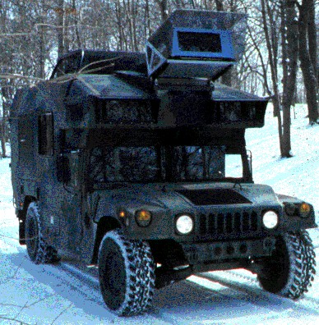
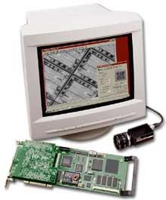
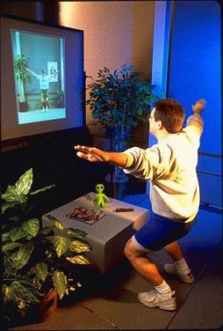
Examples
MIT Media Lab
CMU NavLab
Cognex

Slide 30
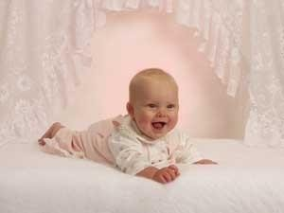
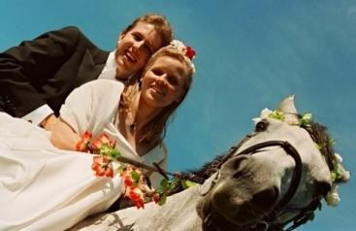
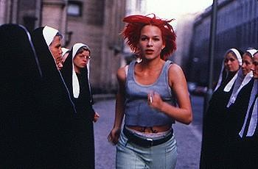
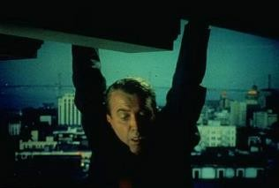
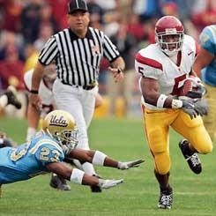

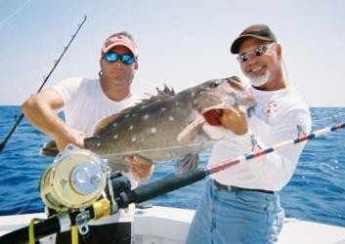
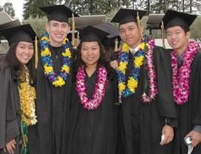
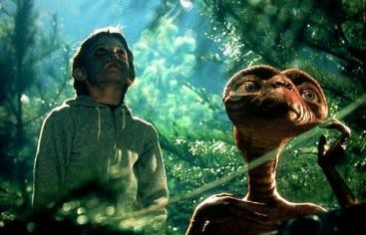
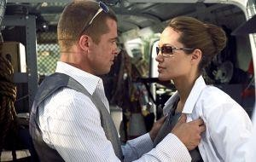

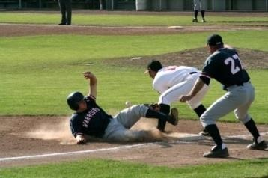






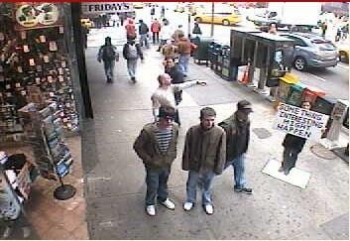
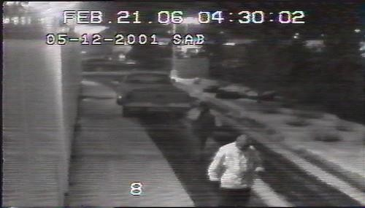
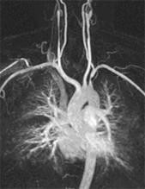
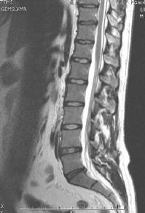
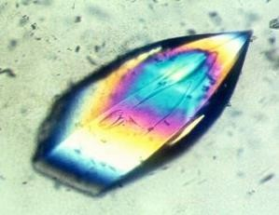









More Examples
Images and video are everywhere!
Personal photo albums
Movies, news, sports
Surveillance and security
Medical and scientific images
Slide credit; L. Lazebnik

Slide 31


Optical character recognition (OCR)
Technology to convert scanned docs to text
If you have a scanner, it probably came with OCR software
Digit recognition, AT&T labs http://www.research.att.com/~yann/
License plate readers
http://en.wikipedia.org/wiki/Automatic_number_plate_recognition

Slide 32

Face detection

Slide 33


Smile detection?
Sony Cyber-shot® T70 Digital Still Camera

Slide 34

Object recognition (in supermarkets)
LaneHawk by EvolutionRobotics
“A smart camera is flush-mounted in the checkout lane, continuously watching for items. When an item is detected and recognized, the cashier verifies the quantity of items that were found under the basket, and continues to close the transaction. The item can remain under the basket, and with LaneHawk,you are assured to get paid for it… “

Slide 35

Face recognition
Who is she?

Slide 36



Vision-based biometrics
“How the Afghan Girl was Identified by Her Iris Patterns” Read the story

Slide 37




Login without a password…
Face recognition systems now beginning to appear more widely http://www.sensiblevision.com/
Fingerprint scanners on many new laptops, other devices

Slide 38


Object recognition (in mobile phones)
This is becoming real:
Microsoft Research
Point & Find, Nokia
SnapTell.com (now amazon)

Slide 39


Special effects: shape capture
The Matrix movies, ESC Entertainment, XYZRGB, NRC

Slide 40


Special effects: motion capture
Pirates of the Carribean, Industrial Light and Magic Click here for interactive demo

Slide 41

Sports
Sportvision first down line
Nice explanation on www.howstuffworks.com

Slide 42

Smart cars
Slide content courtesy of Amnon Shashua

Slide 43

Smart cars
Slide content courtesy of Amnon Shashua

Slide 44



Vision-based interaction (and games)
Digimask: put your face on a 3D avatar.
Nintendo Wii has camera-based IR tracking built in. See Lee’s work at CMU on clever tricks on using it to create a multi-touch display!
“Game turns moviegoers into Human Joysticks”, CNET
Camera tracking a crowd, based on this work.

Slide 45

Vision in space
NASA'S Mars Exploration Rover Spirit captured this westward view from atop a low plateau where Spirit spent the closing months of 2007.
Vision systems (JPL) used for several tasks
Panorama stitching
3D terrain modeling
Obstacle detection, position tracking
For more, read “Computer Vision on Mars” by Matthies et al.

Slide 46


Robotics
NASA’s Mars Spirit Rover http://en.wikipedia.org/wiki/Spirit_rover
http://www.robocup.org/

Slide 47


Medical imaging
3D imaging
MRI, CT
Image guided surgery Grimson et al., MIT

Slide 48

Multimedia database applications

Slide 49


Labeling images

Slide 50

Vision and computer graphics
Eyematic Interfaces

Slide 51




Vision for Biometrics
Viisage

Slide 52
Example application: Face recognition
If we could reliably detect and recognize faces in images…
Digital libraries
Find me the picture of my brother and Ted
Show all the scenes with more than four people
Surveillance
Alert the operator when a known suspect enters the area
HCI
Automatically log in as I walk up to the computer
Refuse to open my files when someone else is at my machine
Military
Friend or foe?
Personal/entertainment robots
Follow the master, look the customer in the eyes

Slide 53
So… why study computer vision?
“Engineering” reasons
Images are become more and more ubiquitous
Plenty of useful applications
Great mixture of applied mathematics, signal processing, computer science, etc.
Solving interesting, underconstrained (“ill-posed”) problems
Etc.
“Science” reasons
How does the brain do it?
Understanding biological vision
Deep computational issues
Etc.

Slide 54
What will we study (not in order)?
Part I: The physics of imaging
Camera models and calibration
Radiometry
Color
Part II: “Early” vision
Filtering and edge detection
Stereo, optical flow
Part III: “Mid-level” vision
Segmentation
Classification
Tracking
Part IV: “High-level” vision and applications
Model-based vision
Various applications of computer vision

Slide 55
Computer Vision
Areas of study
Camera (sensor) calibration and image formation
Binary image analysis
Edge detection and low-level filtering
Color representation and segmentation
Texture description and segmentation
Depth/shape from X
Stereopsis
Optical flow
Motion computation
Object matching, detection, and recognition
3D sensing and shape description
Object and scene tracking

Slide 56



Camera calibration
Original planar
pattern
Corrected for radial
lens distortion
Two calibrated cameras

Slide 57





Edge detection

Slide 58


Slide 59














Slide 60






Stereopsis

Slide 61



Motion computation
Optical flow

Slide 62


Multi-Camera
Stereo
Images
3D reconstruction

Slide 63
















Slide 64


Object Detection and Recognition
Model, detect, and recognize objects in images
Main issues
Object representation, feature extraction, matching, learning from data
Cars
Faces

Slide 65



Texture analysis

